Slide 1
Disaster Relief Supply Distribution Blockchain

Slide 2
Hurricane Katrina, USA
770,000 Residents Affected
What supplies are needed, how much, when, where?

Slide 3
2011 Earthquake, Japan
465,000 Residents Affected
How best to coordinate with other NGOs, agencies?

Slide 4
Tsunami, Indonesia
655,000 Residents Affected
How do we prevent oversupply, waste, double aid?

Slide 5
ReliefChain
What Is It
Decentralised NGO Blockchain Client
Chain contains
Citizens
NGOs
Coordinated Disaster Response
Disaster Event Reporting

Slide 6
ReliefChain
ReliefChain
What Does It Do
Solves multi-agency supply coordination problem
Reduces waste
Tracks distribution
Post-event reporting and analysis
Disaster proof

Slide 7
ReliefChain
Timeline
Disaster strikes
First NGO creates an event on ReliefChain
Other NGOs commit to deliver shortfall items
Supplies delivered to Ground Zero
Supplies are distributed and tracked

Slide 8
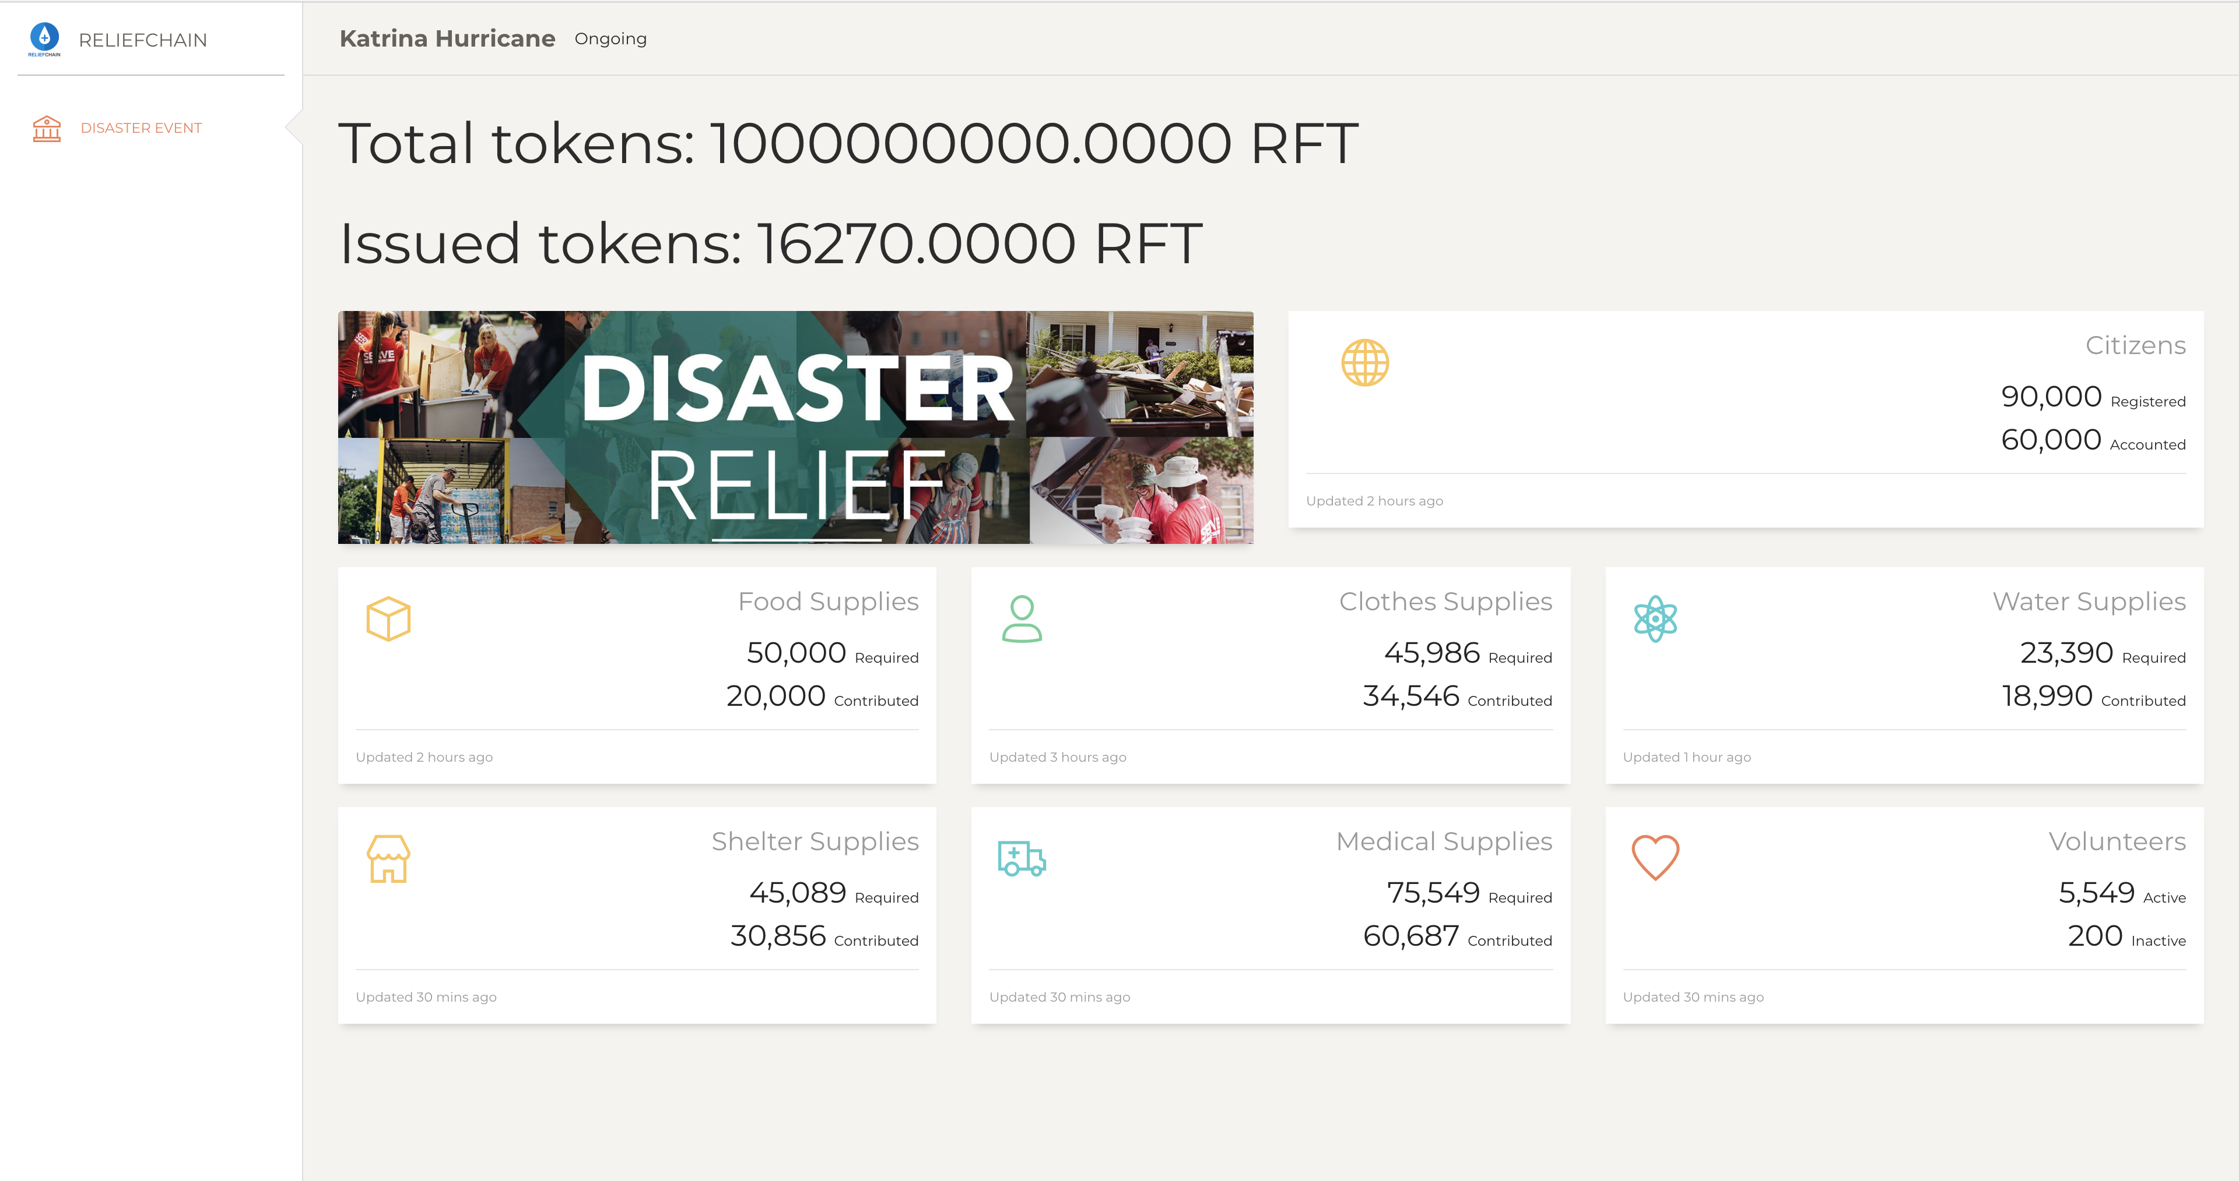
Disaster Event

Slide 9
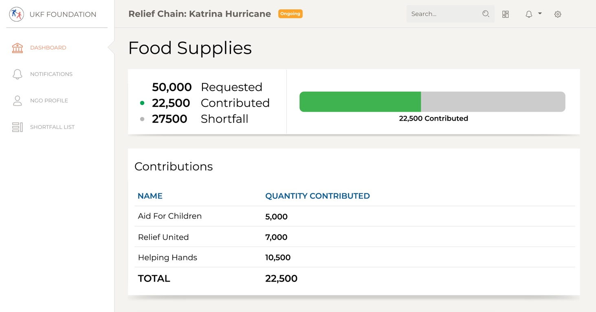
During disaster

Slide 10
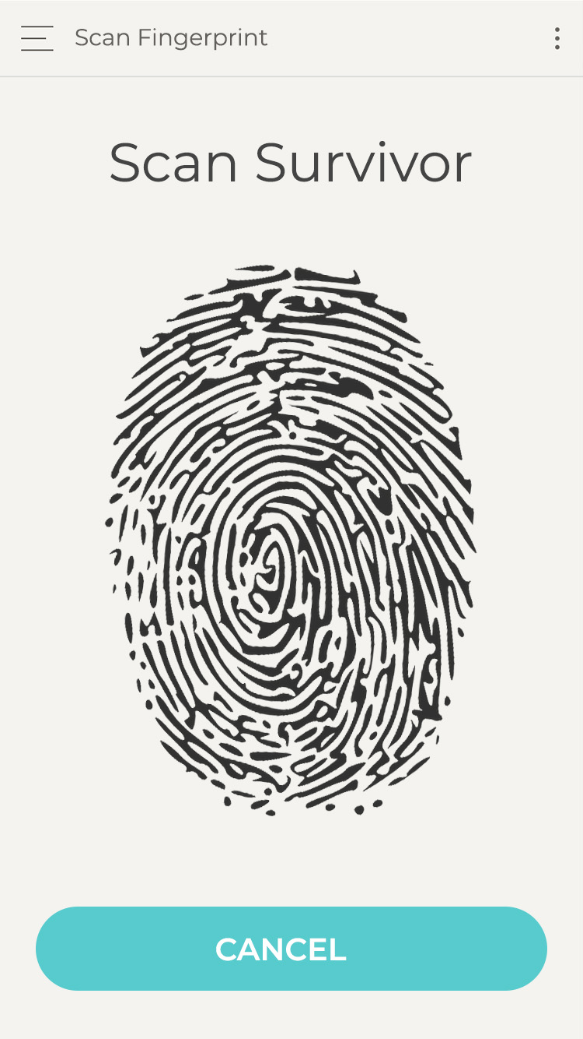
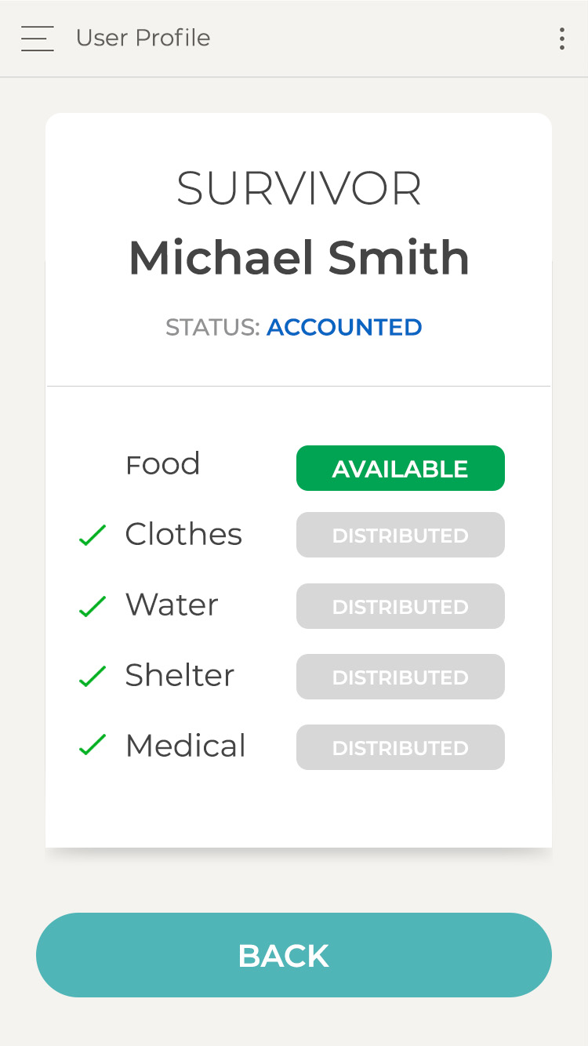
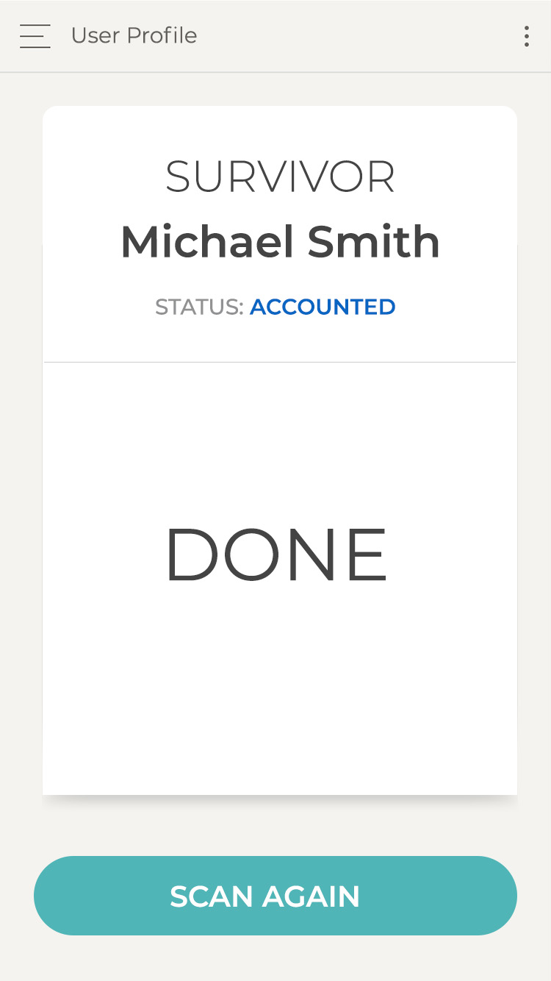
On The Ground

Slide 11
Post-Event Reporting

Slide 12
3 min tech demo
https://www.youtube.com/watch?v=UCGLGSpv-j0

Slide 13
Source code
https://github.com/serganus/ReliefChain-smartcontracts

